Slide 1
First of two slide sets for Meeting #2 Supplemental Material for: Building a Collaborative Community of Practice to Improve Information and Referral Services with Persons with Intellectual and Developmental Disabilities and Community Stakeholders: A procedures manual for state and local disability organizations, including Special Olympics Programs
This project was completed with a grant from Special Olympics. Special Olympics Health is supported by cooperative agreement #NU27DD001156 from the U.S. Centers for Disease Control and Prevention (CDC). The contents of this procedures manual and supplemental materials are the responsibility of Special Olympics and do not necessarily represent the views of CDC. The mark “CDC” is owned by the US Dept. of Health and Human Services and is used with permission. The contents of this procedures manual do not necessarily represent the views of CDC. The project also is funded, in part, by the Rural Institute at the University of Montana, Montana’s University Center for Excellence in Developmental Disabilities, Grant #90DDUC0010-01-00. The content and opinions expressed in this manual do not necessarily represent the U.S. Administration on Community Living or the U.S. Government.
Recommended Citation: Traci, M., Farley, D., Steven, S., Pittaway, M., & Iverson, J. (2019). Building a Collaborative Community of Practice to Improve Information and Referral Services with Persons with Intellectual and Developmental Disabilities and Community Stakeholders: A procedures manual for state and local disability organizations, including Special Olympics Programs. University of Montana, Missoula, Montana. ©RTC: Rural 2019

Slide 2
Improving Information and Referral Services with Persons with Intellectual and Developmental Disabilities and Community Stakeholders Steering Committee Meeting #2 Insert date and location
Project Team:

Slide 3
Agenda
12:00 P.M. Sign-in, lunch, and introductions
12:15 P.M. Project team updates – review slides from first meetings
12:30 P.M. Advocates share draft scripts with stakeholders for input and feedback
1:15 P.M. Review disability resource lists for Missoula 211 area and suggest additions– identify plan to finalize list
1:30 P.M. Review 211 agency/services forms and ways to make forms inclusive

Slide 4
Steering Committee Meeting Update

Slide 5
Introductions
Summarize how the day started with introductions
Include pictures below

Slide 6
Pictures of Lunch and engagement here
Lunch provided by ____-- thank you!

Slide 7
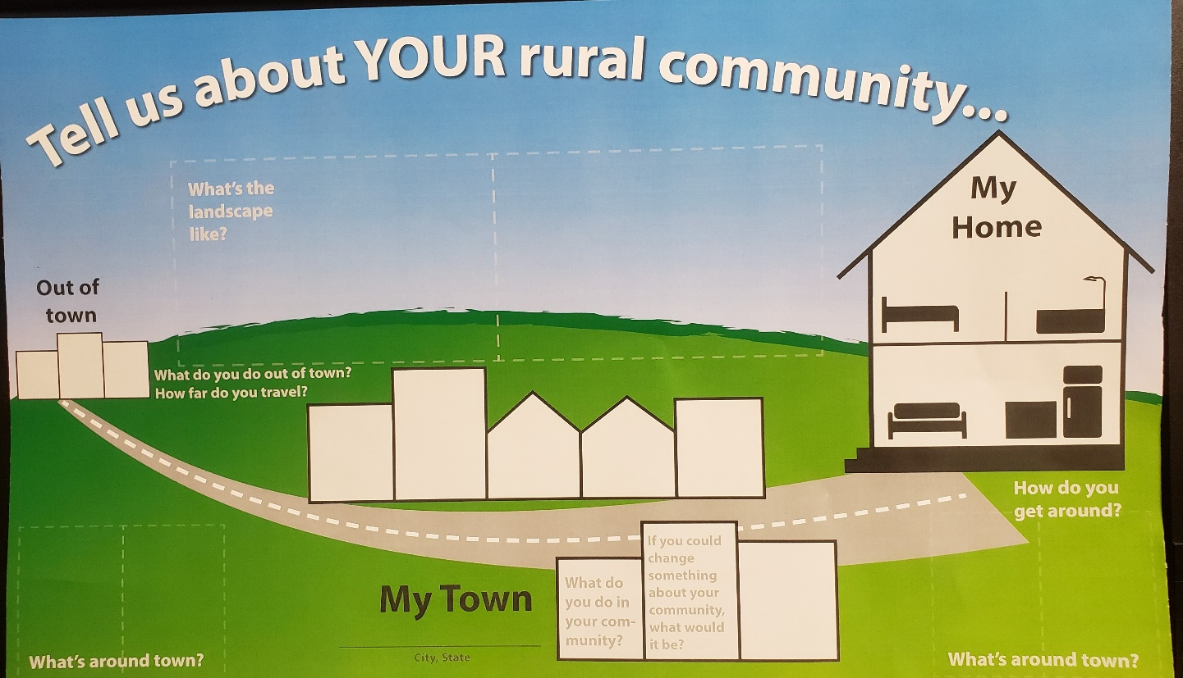
Assets Mapping Activity
What do you do in your community?
What is most important to you about your home?
What do you do out of town?
How did you find the place you live?
How far do you travel?
How do you get around Town?
If you could change something about your community, what would it be?

Slide 8
Results
Include pictures of the steering committee engaging with the assets mapping activity
Include pictures of sticky notes on the assets map itself
Summarize the activity verbally on this slide

Slide 9
Results
We created a list of all the resources mentioned in the assets mapping activity
Include picture here
Include picture here
2. We compared that list to our current data base of resources

Slide 10
What We Learned
List community resources mentioned during the assets mapping activity
To name a few…
Free bus transportation
Public library
Food bank and free cooking classes

Slide 11
What We Learned
We become connected to resources in our community in a variety of ways
Word of mouth, hearing from a friend
Agencies such as SUMMIT or Opportunity Resources
Online information seeking
Case manager or Job Coach

Slide 12
What We Learned
Although Missoula offers many resources, we still find gaps in becoming connected to them
211 can help with making those connections!
We need to promote awareness of 211 among persons with IDD and their family and friends.

Slide 13
Moving Forward
We will meet again in (month of meeting #3) to:
Develop social marketing messages to promote awareness of 211 among persons with IDD and community organizations that support persons with IDD;
Highlighting community resources and information important for persons with IDD community;
2) Develop training on how 211 works for persons with IDD;
3) Develop recommendations for sustaining an approach within 211 that is inclusive of persons with IDD; and

Slide 14
What happened this morning? (please refer to meeting agenda #2)
9 A.M. Introductions and break into small groups
Icebreaker: Name, something you connected to recently, how did you get connected?
Review PowerPoint
What is 211 video from Ronan
9:15 A.M. Using 211 website to answer common questions
211 website demonstration
Common questions
10:00 A.M. Creating a 211 how-to-video: first steps?
Give out questions
Example of how to write instructions: paper airplane
Improv Game: Writing Clear Instructions
10:45 A.M. Draft a script that shows how to use the Montana 211 website to find a needed resource

Slide 15
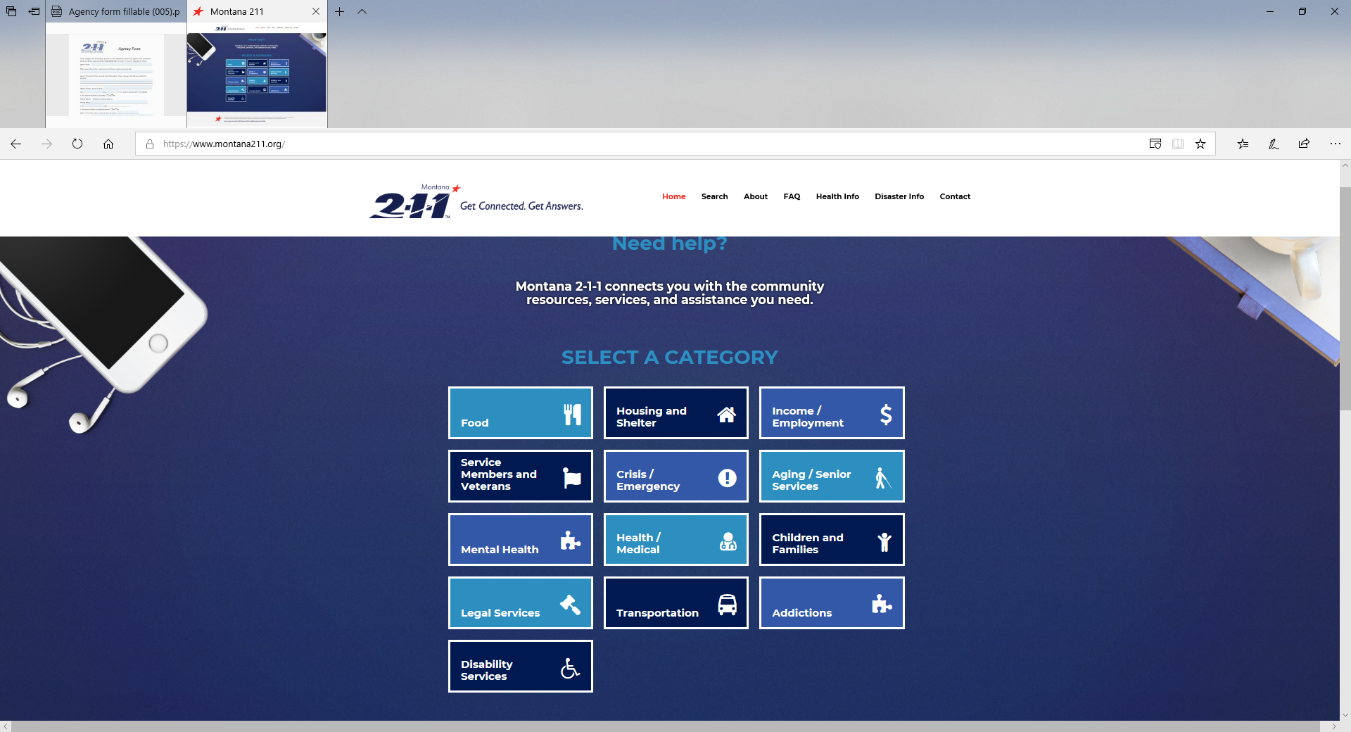
How to use the 211 Website to Start to Address Common Problems
Note: The above screen shot is from Montana 2-1-1. Please use your local 2-1-1 webpage.

Slide 16
How to connect with resources improv game
HOUSING (1/2 SETS OF QUESTIONS)
Where can I find a safe place to sleep tonight?
Where can I find an affordable home? Like an apartment to rent? Who can help me?
Where can I find help with home repairs or maintenance?
Where can I find help paying my rent?
Where can I find a home to buy? Who can help me?
Where can I find help paying my mortgage, home insurance, or property taxes?
Who can help me deal with landlord?
Using Montana 2-1-1 and commonly asked questions about housing

Slide 17
How to connect with resources improv game
HOUSING (2/2 SETS OF QUESTIONS)
Where can I find a safe place to sleep tonight?
Where can I find an affordable home? Like an apartment to rent? Who can help me?
Where can I find help with home repairs or maintenance?
Where can I find help paying my rent?
Where can I find a home to buy? Who can help me?
Where can I find help paying my mortgage, home insurance, or property taxes?
Who can help me deal with landlord?
Using Montana 2-1-1 and commonly asked questions about housing continued

Slide 18
How to connect with resources improv game
Community and Independent Living
Where can I find people who understand what it means to live in the community with a disability?
Where can I find a lawyer to help me fight for my civil rights as a person with a disability?
Where can I find a government agency who helps people with intellectual and development disabilities?
Where can I find a case manager or someone who will help me to stay healthy in the community?
Community and Independent living commonly asked questions for 2-1-1

Slide 19
How to connect with resources improv game
HEALTH AND WELLNESS
Where can I find healthy and affordable food?
Where can I find a place and the tools to garden?
Where can I find a place to exercise?
Commonly asked questions for 2-1-1 regarding health and wellness

Slide 20
How to connect with resources improv game
Finances and Household Bills
Where can I find help paying my bills for my electricity, heat, water, phone, or internet?
Where can I find help getting a job?
Where can I find help with money problems?
Where can I find help buying clothing for job or something I need for my house like a refrigerator?
Commonly asked questions for 2-1-1 regarding finances and household bills

Slide 21
How to connect with resources improv game
Health Care and Supports
Where can I find a doctor who will take Medicaid?
Where can I find a dentist who will take Medicaid?
Where can I find help paying my healthcare bills?
Where can I find help with my alcohol and drug addictions?
Where can I find help with mental health?
Commonly asked questions for 2-1-1 regarding health care and support

Slide 22
How to connect with resources improv game
EMERGENCY AND DISASTER PREPAREDNESS
Where can I find help with my smoke alarm?
Where can I find help getting clean air during wildfire smoke season?
Where can I find help during a disaster?
Commonly asked questions for 2-1-1 regarding emergency and disaster preparedness

Slide 23
How to connect with resources improv game
JOB AND VOCATIONAL SUPPORTS
Where can I find help getting child care?
Where can I find help to be a better parent or child caregiver?
Where can I find education or classes that will help me?
Where can I find transportation to go where I want to go?
Commonly asked questions for 2-1-1 regarding job and vocational support

Slide 24
What have we developed to teach others? What could we develop?
Educational and Promotional Materials

Slide 25
Educational and Promotional Materials
Social Marketing– What is it? And who is it for?
Content for Social Media– Youtube, Instagram, Twitter, Face Book
Public Service Announcements (PSAs)
Training materials (e.g., for presentations at People First meetings)
Information to embed in person-centered planning materials

Slide 26
Results of this mornings work

Slide 27
What do we have to share with 2-1-1?
What could we help develop?

Slide 28
Comprehensive and Up-to-date List for 211
Agency and Partners’ Directories and Lists
Steering Committee Input
211 Database

Slide 29
Inclusive Approach When a community resource is identified, what do people with disabilities need to know?

Slide 31
Consider the difference in these images when thinking about how 2-1-1 can be more inclusive
Separate categories
Inclusive Categories

Slide 32
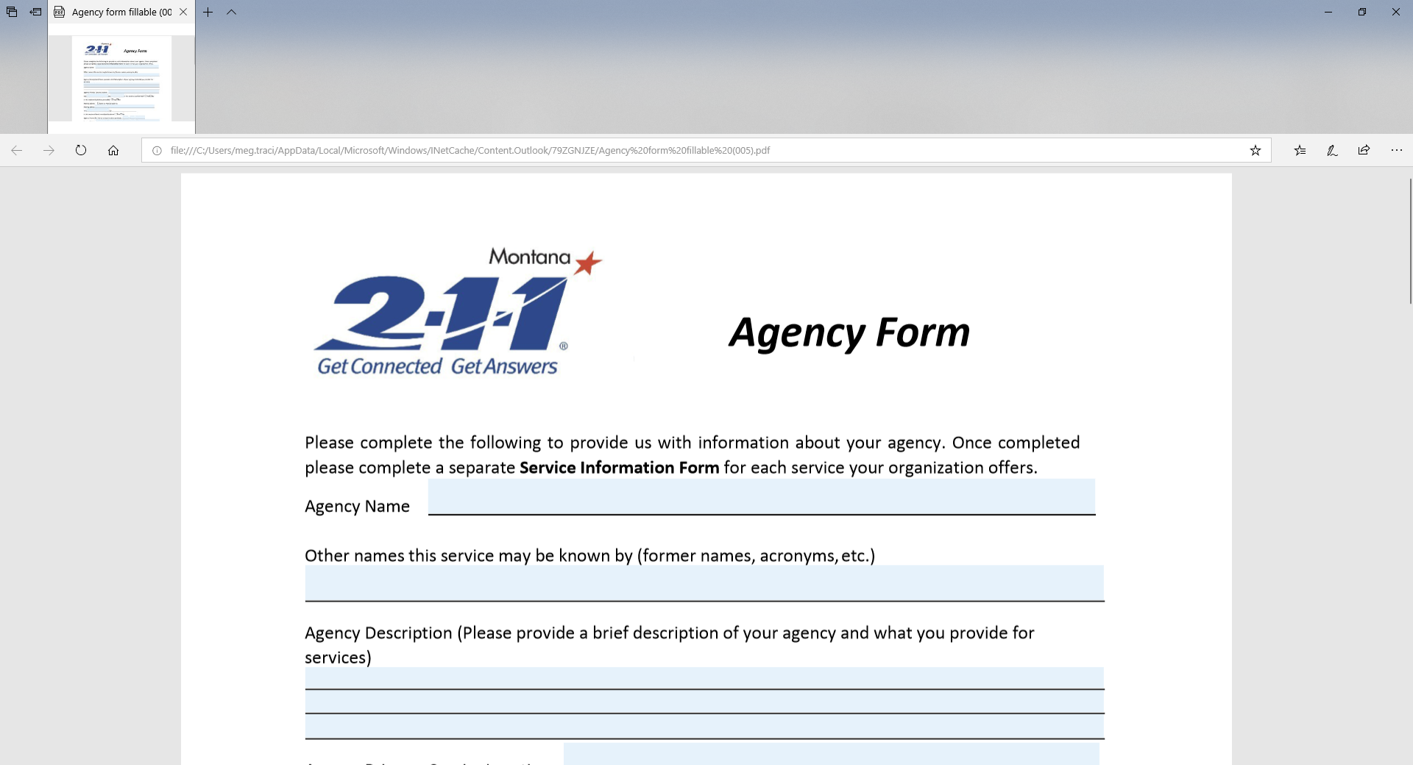
How can we change the way agencies appear in the system?

Slide 33
What other questions should be asked?
What else do we need to know?

Slide 36
Suggestions to start the conversation
National Center on Health, Physical Activity and Disability
Community Health Inclusion Index (CHII)—the organizational assessment (available at: https://www.nchpad.org/fppics/CHII_Organizational%20Assessment.pdf )
Adopted from CHII Q6.03
Q. Which of the following activities does your organization engage in to promote the participation of persons with disabilities? (Check all that apply)
Definition of ACCESSIBLE - refers to a site, facility, work environment, service, or program that is easy to approach, enter, operate, and/or use safely and with dignity by a person with a disability. In this case, an accessible location would allow for someone with a disability to independently enter the building, navigate to a room where the program is held, enter e room, and have a place in the room where they could participate equally with peers.

Slide 37
Suggestions to start the discussion
National Center on Health, Physical Activity and Disability
Q. Which of the following activities does your organization engage in to promote the participation of persons with disabilities? (Check all that apply)
Definition of ACCESSIBLE - (See prior slide for definition)
Includes members representing a disability perspective, such as an ADA compliance officer, a special education teacher, or certified inclusive fitness trainer
Sets goals that are geared towards persons with disabilities
Has meetings and programs in accessible locations
Communicates using accessible formats (e.g., compatible with screen readers)
Provides transportation options that are accessible.
Provides health care and services, accessible equipment and rooms are used
None of the above
Other _______________________________________________________

Slide 38
What else do we need to know?

Slide 42
Suggestions to start the discussion
U.S. DHHS Data Standard for Disability Status
1) Are you deaf or do you have serious difficulty hearing?
2) Are you blind or do you have serious difficulty seeing, even when wearing glasses?
3) Because of a physical, mental or emotional condition, do you have serious difficulty concentrating, remembering, or making decisions? (5 years and older)
4) Do you have serious difficulty walking of climbing stairs?
(5 years and older)
5) Do you have difficulty dressing or bathing? (5 years and older)
6) Because of a physical, mental, or emotional condition do you have difficulty doing errands alone such as visiting a doctor’s office or shopping? (15 years and older)

